Slide 1
Neural Networks
Dr. Thompson
March 19, 2013

Slide 2
Artificial Intelligence
Robotics
Computer Vision & Speech Recognition
Expert Systems
Pattern Recognition
Machine Learning
Natural Language Processing
Prognostics & Diagnostics

Slide 3
Neural Network Applications
Character Recognition
Loan Officer
Cancer Diagnosis
Wine Classifier
Stock Market Prediction
Network Security

Slide 4
HRL
Artificial Neural Networks - Pattern Recognition
Airbag Problem – Accelerometer False Positive
OCR Check Character Recognition
Bayesian Networks – Expert System
GM Electromotive Division
Amazon.com Buyer Preferences

Slide 5
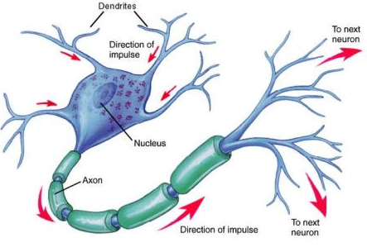
Biological Neuron

Slide 6
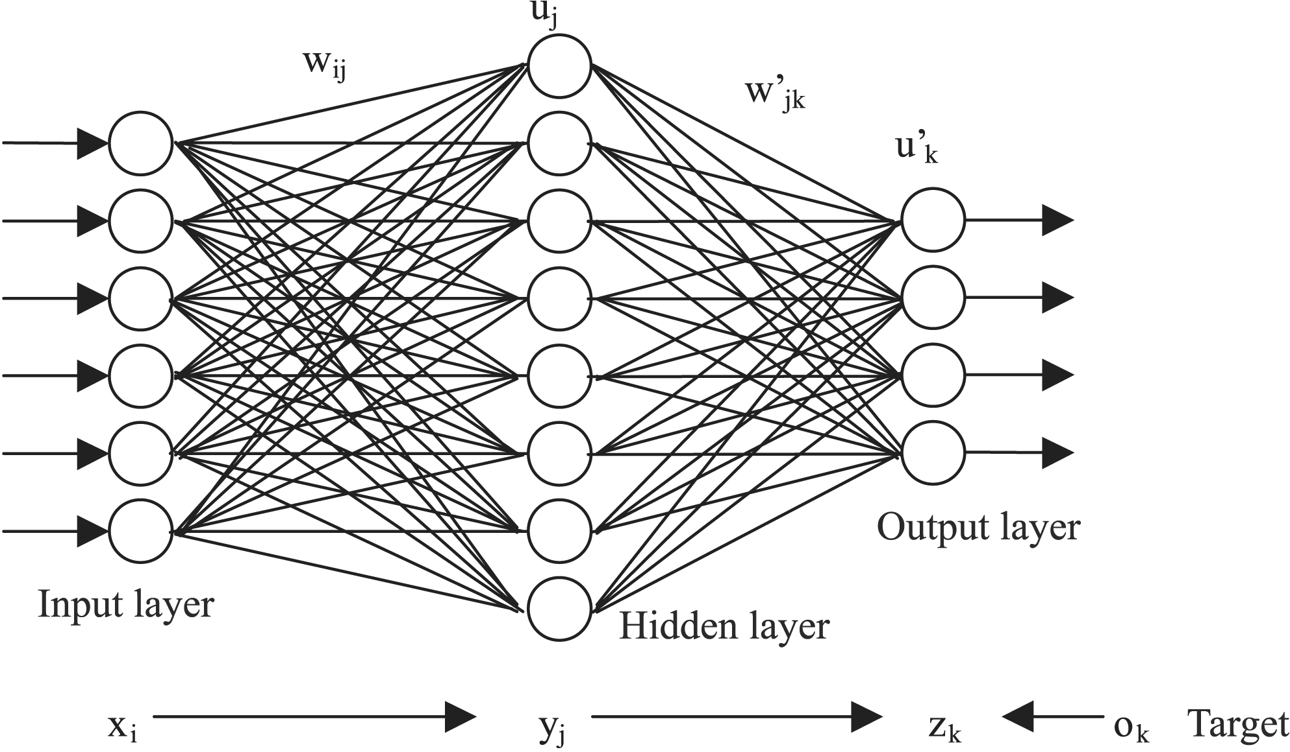
Artificial Neural Network Topology

Slide 7
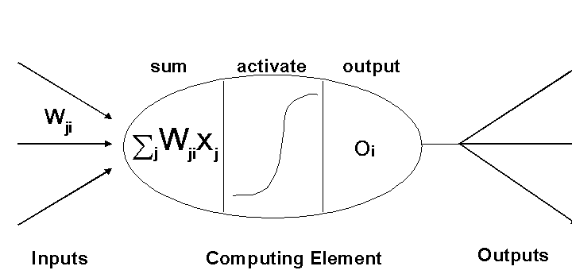
Artificial Neuron Activation

Slide 8
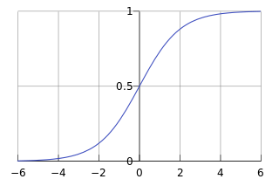
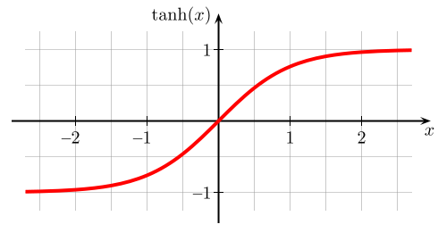
Threshhold Functions (include graphs)
Linear
Logistic
Hyperbolic Tangent – Sigmoid (*)
Step
Logistic Curve

Slide 9
Network Output
Y = f(WX)
Z = f(W’Y) = f(W’f(WX))

Slide 10
Error Correction
(Method of Least Squares)
Minimize Total Error = E = Σ (Z-O)²

Slide 11
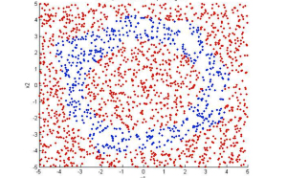
Solution Space

Slide 12
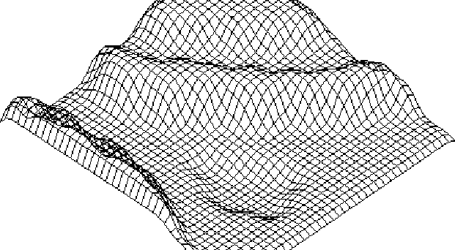
Error Function: Local & Global Minima

Slide 13
Back Propagation Delta Rule – Gradient Descent
http://en.wikipedia.org/wiki/Delta_Rule

Slide 14
Learning & Testing
Heuristics
10%
90%
Overtraining/Overfitting
Polynomial Curve Fitting Analogy

Slide 15
Next Week Matlab Neural Network Toolbox Tutorial

Slide 16
Assignment
Read the Wikipedia Artificial Neural Network & Backpropagation Chapters
Devise a Neural Network Characterization of
4x4 Scoreboard Digit Problem
Input Layer
Hidden Layer
Output Layer
Training Set Examples

